Slide 1
Grocery case-study
By: Morad Moqbel

Slide 2
Purpose of study:
Analyzing sub-categories and their relationship with sales and discounts
Study’s tools:
Power BI

Slide 3
Data summary
Our data comes from Coscto’s online market.
Our data contains only 4 fields related to our study, and they are respectively:
Sub-category (Snacks, Meat & Seafood, Beverages, Candy etc)
Discount (Ranges between 0-80% OFF)
Price (Ranges between $3.99 for the cheapest product and $1999.9 for the most expensive product)
Net price (after the discount)

Slide 4
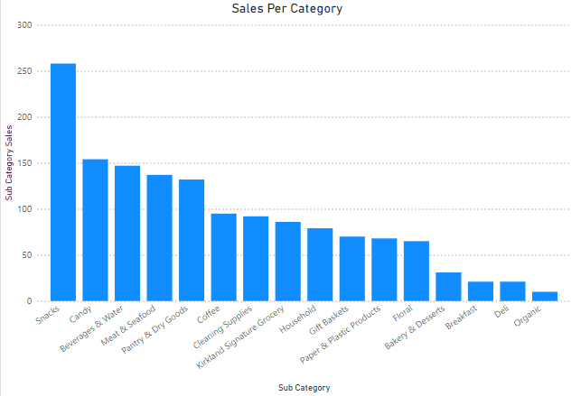
Sales per category
This photo depicts that Snacks category has sold more than all the other categories, while the Organic category has sold the fewest.

Slide 5
Q1: Does that mean the snacks category reached the highest revenue ?

Slide 6
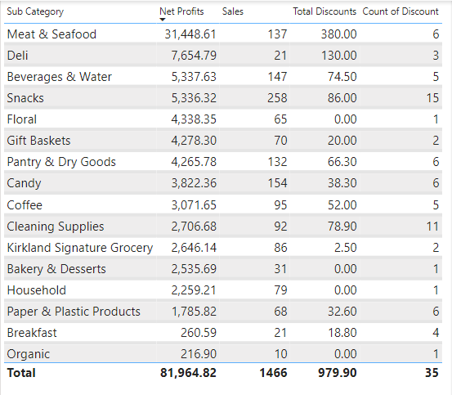
Do More sales mean higher revenue?
As shown in the image, Meat & Seafood reached out the highest revenue, even though it sold nearly 50% of what Snacks category has sold!

Slide 7
Q2: Do more offers and discounts mean more sales?

Slide 8
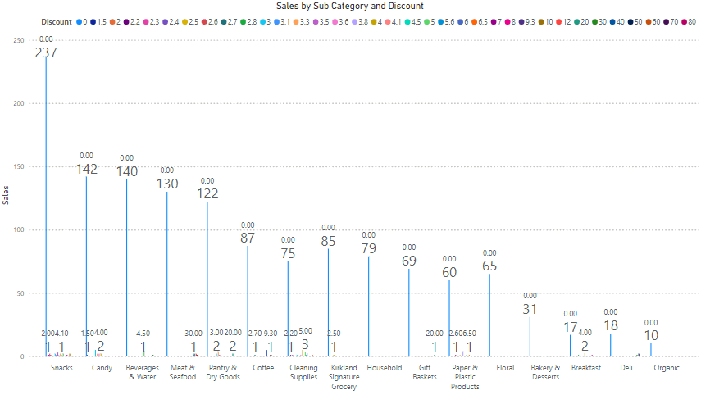
Do more offers and discounts mean more sales?
Despite the many offers and discounts,
people tend to buy products that do not have discounts.
(As its shown in the image)

Slide 9
What are the reasons behind that?
Some reasons include:
Poor marketing, as people may not know that there are discounts.
Discounts on items that people not interested in purchasing

Slide 10
Recommendations
Good marketing, where people notice the amount of discount.
Focusing on products that are usually considered expensive, and on brands.(people feel good when they notice a discount on expensive products )
Focusing on products that people are interested in purchasing.

Slide 11
End of our study, hope you enjoy it!
for any question, please email me at: mrdyumr@gmail.com

